Slide 1
DEEP LEARNING THEORY–BASED PRACTICAL WORK
Phase 2 · Solution Design
Cross-Subject Motor Imagery EEG
Classification using Deep Learning
A hybrid convolutional–Transformer approach evaluated on unseen subjects
Team members
[ Names and registration numbers ]
Guide / faculty
[ Name and designation ]
Course
[ Course code and title ]
Date
15 September 2026
Notes:
Phase 2 presents the solution design: how the literature survey from Phase 1 becomes a concrete, implementable project plan. Fill in team, guide and course before presenting.

Slide 2
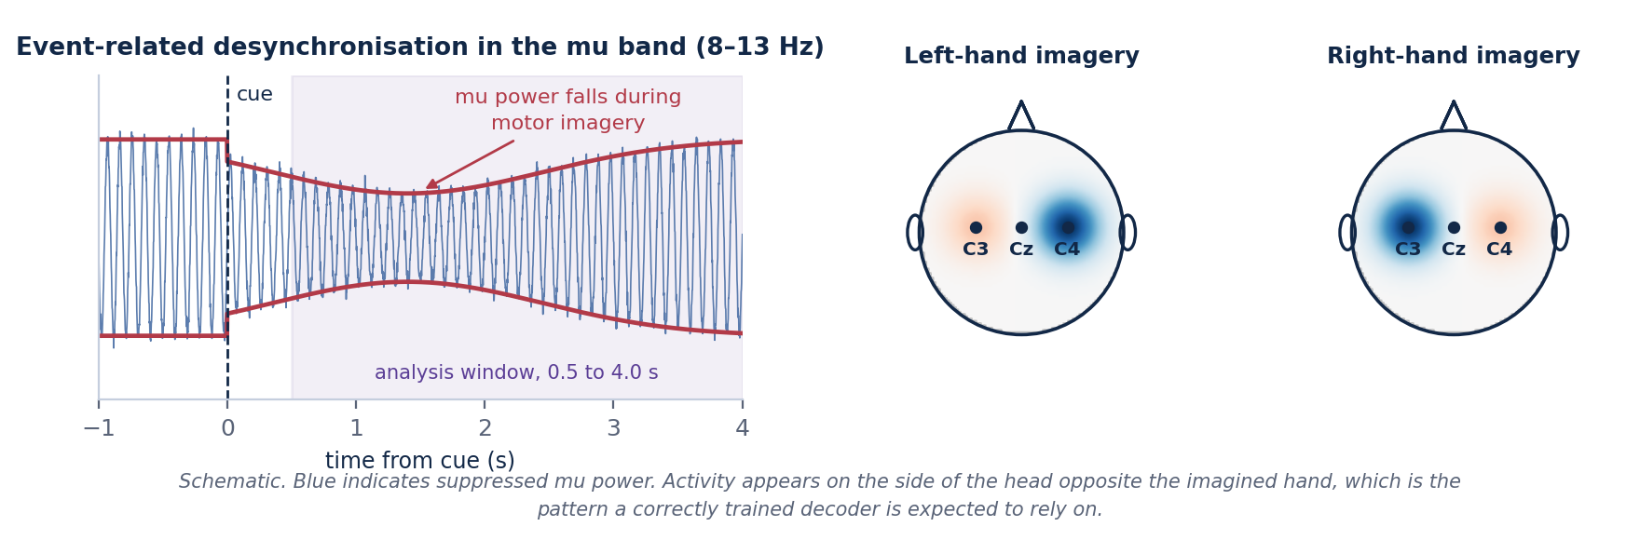
PROBLEM STATEMENT
Decoding imagined movement from scalp EEG
When a person imagines moving a limb, the sensorimotor cortex shows a measurable drop in mu-band power on the opposite side of the head. The task is to recover which movement was imagined from that signal.
Low signal-to-noise ratio
Small, high-dimensional data
Variability between people
Cortical activity is attenuated by the skull and scalp, and is mixed with eye, muscle and mains interference
A four-second trial holds over twenty thousand samples, but each subject provides only a few hundred labelled trials
Skull shape, electrode placement and mental strategy differ, so feature distributions shift from subject to subject
2
Notes:
Three difficulties: noise, data scarcity, and subject variability. The third is the one this project targets.

Slide 3
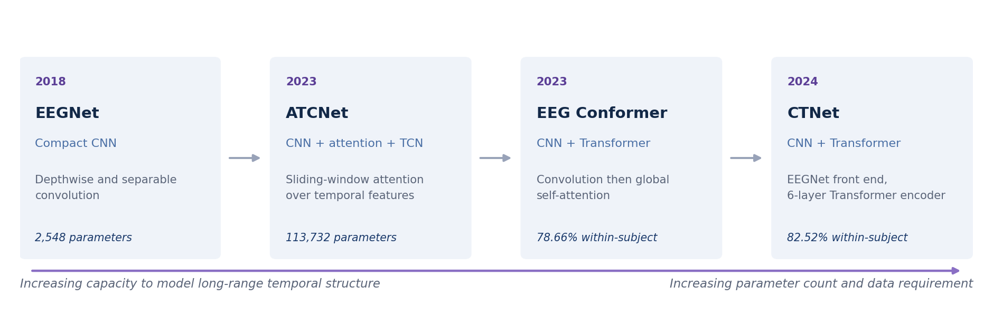
LITERATURE SURVEY SUMMARY
From compact CNNs to convolutional–Transformer hybrids
What improved
What it cost
Each step added a better way to relate information across the whole trial, rather than only within a short window.
Parameter counts rose from roughly two thousand to over one hundred thousand, and the data requirement rose with them.
3
Notes:
The four papers form a progression: CNN, then CNN with attention and temporal convolution, then CNN with a Transformer encoder. Capability rose, and so did cost.

Slide 4
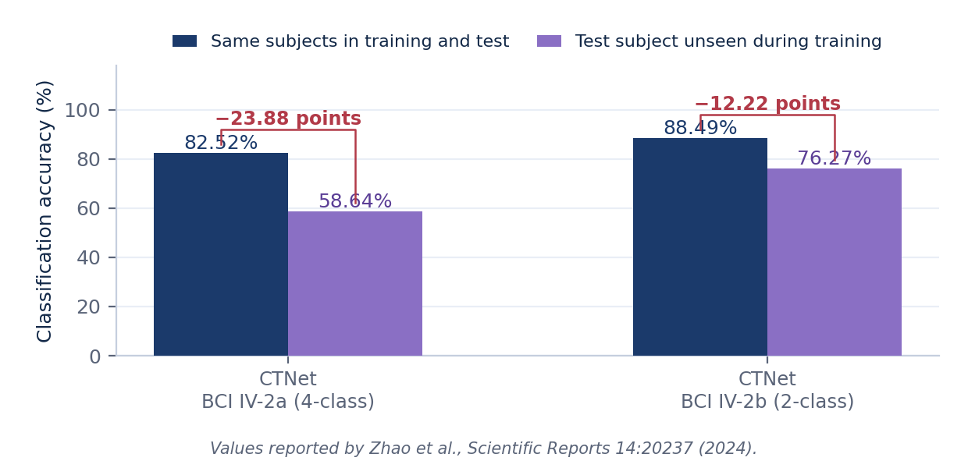
RESEARCH GAP
Four limitations common to the surveyed work
Cross-subject generalisation remains difficult; accuracy falls when the test subject is unseen.
1
Zero-calibration and low-calibration operation is still an open problem.
2
CNNs are lightweight but limited in modelling long-range temporal structure.
3
Transformers capture global relationships but cost more and need more data.
4
What is needed
The clearest illustration
A model that balances classification accuracy, model complexity and generalisation to new people, rather than optimising any one of them alone.
CTNet is the strongest of the four within subject, yet loses 23.88 points on the four-class task when the test subject is unseen.
4
Notes:
CTNet is the clearest illustration: 82.52 per cent within subject, 58.64 per cent on an unseen subject. Nearly twenty-four points.

Slide 5
PROJECT OBJECTIVES
What the project sets out to do
Implement a reproducible preprocessing and evaluation pipeline for BCI Competition IV Dataset 2a.
Implement EEGNet, ATCNet, CTNet and EEG Conformer as baselines under one identical protocol.
1
2
Design a hybrid model combining the convolutional front end of EEGNet with the attention mechanisms of the other three.
Train and evaluate every model using leave-one-subject-out cross-validation.
3
4
Measure accuracy, Cohen's kappa, precision, recall and F1-score, per subject and averaged.
Compare parameter count and computational cost alongside accuracy.
5
6
The final objective is to report whether the proposed combination improves cross-subject performance while remaining lightweight — and to report it either way.
5
Notes:
Six objectives. The seventh, on the purple band, is the honesty commitment: a negative result is still reported.

Slide 6
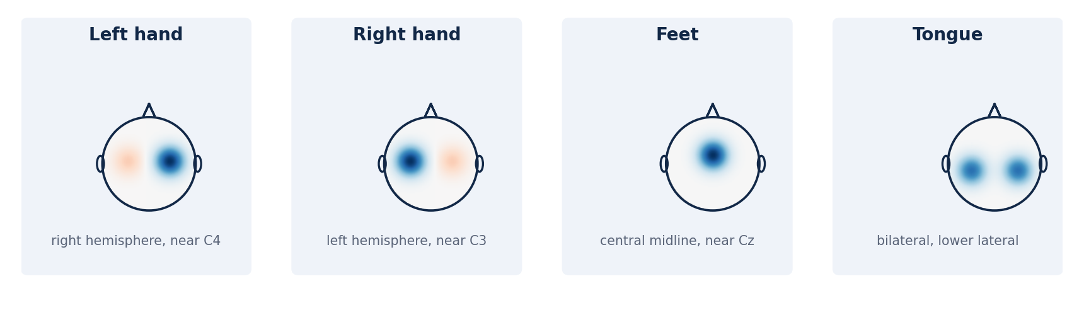
DATASET
BCI Competition IV Dataset 2a
Property | Value
Subjects | 9
EEG channels | 22
Classes | 4 — left hand, right hand, feet, tongue
Sampling rate | 250 Hz
Sessions per subject | 2, on different days
Trials per subject | 576
Total labelled trials | 5,184
Analysis window | 0.5 to 4.0 s after cue (875 samples)
The four motor imagery classes
Each class activates a different region of the sensorimotor cortex. Hand imagery appears on the opposite side of the head, foot imagery near the midline.
Chosen because all four surveyed papers evaluate on it, so our baseline implementations can be checked against published values.
With only nine subjects, leave-one-subject-out gives nine folds — enough for a mean, a standard deviation and a paired test, but not enough to treat any single fold as reliable on its own.
6
Notes:
Nine subjects, four classes, 576 trials each. Small by deep learning standards, which is why regularisation and augmentation are necessary rather than optional.

Slide 7
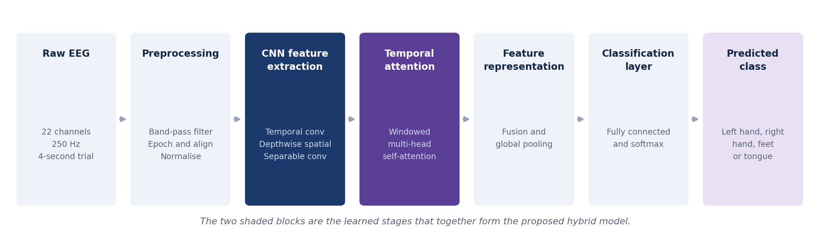
PROPOSED SYSTEM ARCHITECTURE
From raw EEG to a predicted movement
CNN feature extraction
Temporal attention
Depthwise and separable convolution, adapted from EEGNet. Learns spatial filters at very low parameter cost.
Windowed self-attention, adapted from ATCNet, CTNet and EEG Conformer. Relates distant parts of the trial.
7
Notes:
The two shaded stages are the learned components. Everything else is fixed signal processing or output layers.

Slide 8
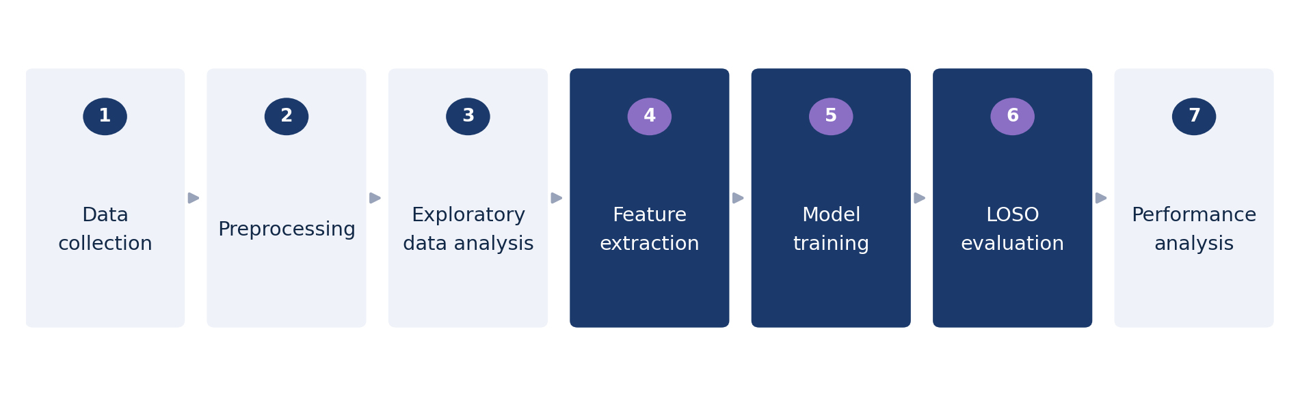
PROPOSED METHODOLOGY
Step-by-step pipeline
Stage | What happens | Why it matters
Preprocessing | Band-pass 4–38 Hz, epoch 0.5–4.0 s, alignment, normalisation | Identical for every model, so differences come from the models
Feature extraction | Convolutional block followed by windowed attention | The learned part of the system
Model training | Subject-independent, validation on a held-out subject | Avoids selecting hyperparameters that favour within-subject fit
LOSO evaluation | Nine folds, each with a different unseen test subject | Measures what a new user would experience
Performance analysis | Metrics per subject, plus a paired statistical test | Averages alone hide failures on individual subjects
8
Notes:
Seven stages. Highlighted ones are where the technical work sits.

Slide 9
BASELINE COMPARISON
Four published baselines and the proposed model
Model | Architecture type | Main strength | Main limitation | Role in our experiments
EEGNet (2018) | Compact CNN | Very small; trains reliably on limited data | Limited long-range temporal modelling | Lower bound on model size
ATCNet (2023) | CNN + attention + TCN | Attention applied locally, suits short trials | Considerably larger than EEGNet | Source of the windowed attention idea
EEG Conformer (2023) | CNN + Transformer | Global self-attention with interpretability | Costly; needs augmentation to train well | Reference for convolution-then-attention
CTNet (2024) | CNN + Transformer | Highest reported within-subject accuracy | Large drop under subject-independent testing | States the research gap quantitatively
Proposed HCT-Net | CNN + windowed attention | Combines the components above at 20,996 parameters | Not yet evaluated | The model under investigation
Published accuracies follow on the next slide, split by protocol: cross-subject results measured under one shared protocol, and within-subject figures that come from different protocols and cannot be ranked against each other.
9
Notes:
Important point to make aloud: the published numbers use different protocols. EEGNet is 68.67 per cent in the ATCNet repository's evaluation and 77.39 per cent in the CTNet paper's re-implementation, for the same model on the same dataset.

Slide 10
PUBLISHED RESULTS
Published results, split by protocol
Cross-subject: one protocol for all (Zhao et al., 2024)
Within-subject: different protocols, not comparable
Model | Unseen person | Kappa
ShallowConvNet+ | 56.75 ± 13.77 | 0.4234
DeepConvNet+ | 60.15 ± 12.71 | 0.4686
EEGNet+ | 56.85 ± 15.82 | 0.4246
EEG Conformer+ | 53.41 ± 17.08 | 0.3789
CTNet | 58.64 ± 14.61 | 0.4486
Model | Same person | Source
CTNet | 82.52% | Zhao et al. (2024)
EEG Conformer | 78.66% | Authors' repository, hold-out
ATCNet | 85.38% | Paper, subject-dependent
ATCNet | 81.10% | ATCNet repository script
EEGNet | 68.67% | ATCNet repository script
EEGNet+ | 77.39% | Zhao et al. (2024), re-implemented
Cross-subject: each subject held out in turn, trained on the other eight for 600 epochs on the 2–6 s window, no alignment and no fine-tuning on the held-out subject. + marks baselines re-implemented by the CTNet authors under the same conditions. This is the reference for our own cross-subject results.
10
Notes:
The left table is the only published comparison of these architectures under one cross-subject protocol that we could verify, so it is our reference. The right-hand figures are all within-subject and come from different evaluations: the same EEGNet scores 68.67 per cent in one and 77.39 per cent in another. An EEGNet figure of 71.50 per cent and a claim that EEGNet and Conformer reach 68 to 70 per cent under leave-one-subject-out appeared in earlier material; neither has a verifiable source, and the second was the within-subject 68.67 per cent mislabelled.

Slide 11
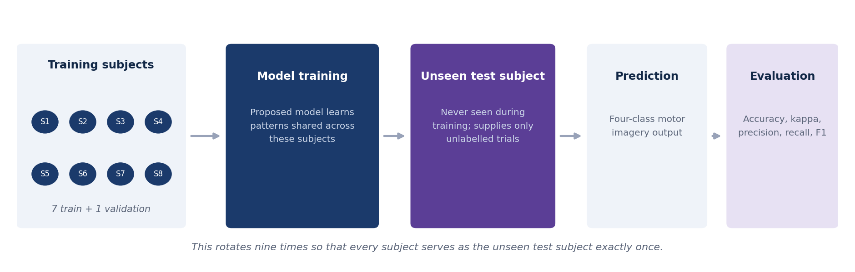
EVALUATION STRATEGY
Leave-one-subject-out evaluation
Accuracy
Cohen's kappa
Precision, recall, F1
Parameters and time
Mean and standard deviation over nine folds
Corrected for chance agreement
Macro-averaged over the four classes
Model complexity and computational cost
A Wilcoxon signed-rank test, paired across the nine subjects, is used to decide whether a difference between two models is meaningful. Results are reported per subject as well as averaged.
11
Notes:
Nine folds. Seven training subjects, one validation subject, one test subject. The validation subject is held out too, which matters for honest hyperparameter selection.

Slide 12
EXPECTED OUTCOMES AND NOVELTY
What we expect, and what is actually new
Expected outcomes
What the project contributes
Better generalisation to unseen subjects than the heavier baselines
A comparison of all four architectures under one identical LOSO protocol
Competitive motor imagery classification accuracy
A specific lightweight combination, with attention depth reduced to suit the dataset size
A lightweight architecture — 20,996 parameters, about one fifth the size of ATCNet
A component-wise study showing what each part contributes to cross-subject accuracy
Reduced dependence on subject-specific calibration
Accuracy measured against parameter count under a single protocol
These are expected outcomes, not results.
No experiments have been run at this stage. The individual components are all taken from published work; what is proposed is the particular combination, the subject-independent evaluation, and the study of what each component contributes.
12
Notes:
Say this explicitly: nothing on the left has been measured. The novelty claim is modest and deliberate — a careful comparative study plus a concrete lightweight design.

Slide 13
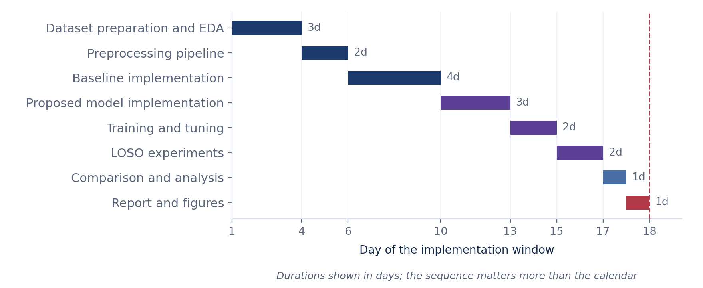
PHASE 3, 16 SEPTEMBER TO 3 OCTOBER
Implementation plan and conclusion
In summary
The literature survey identified a specific, measurable gap: cross-subject accuracy falls sharply, and closing it currently costs model size. Phase 2 turns that into an implementable plan — one dataset, five models, one evaluation protocol, and a fixed schedule. The plan is deliberately front-loaded, so that the pipeline and baselines are verified before the proposed model is written.
13
Notes:
Close here. The point of Phase 2 is that the survey has become a concrete plan that fits the remaining time.

